Slide 1

Engineering Chemistry and Materials Science
Phase Diagrams
Manvinder Lalh
Dept. of Materials Science and Engineering
University of Toronto
December 5th, 2022
APS110/164

Slide 2
Overview
Engineering Chemistry and Materials Science
Quiz
What is a phase diagram?
Binary phase diagrams
What are some key features
Liquidous, solidus, eutectic points
Iron-Carbon Phase Diagram
Lever-rule
Problems
APS110/164

Slide 3

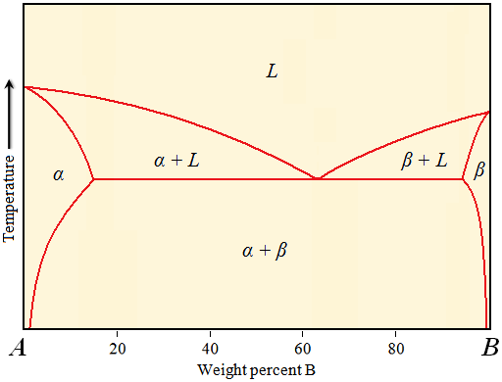
What is a Phase Diagram
Engineering Chemistry and Materials Science
Phase Diagrams
In engineering often have mixtures of many materials to form alloys or compounds
Different compositions of each of the constituents can lead to different results for appearance, strength etc.
Phase diagrams help engineers understand what exactly they’re dealing with
Phase diagrams can accommodate many materials, but are simplest in the form of a binary phase diagram – two different materials
The x-axis left to right represents the wt% of the second material being added in greater quantity to the other material “A” in this case
The y-axis represents temperature, the letters represent phases
APS110/164

Slide 4
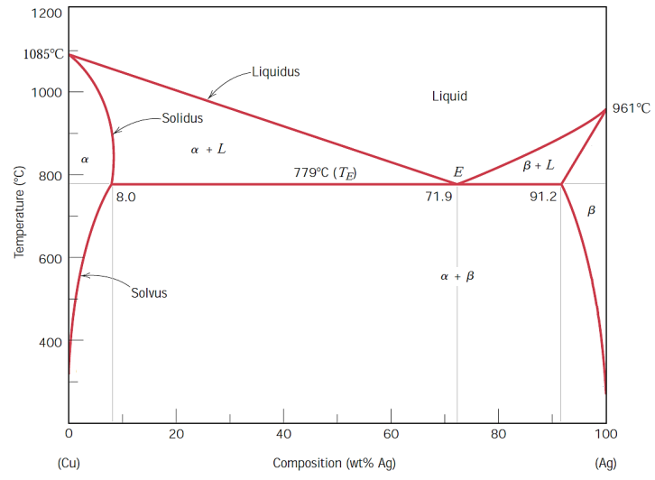
Key Phase Diagram Features
Engineering Chemistry and Materials Science
Phase Diagrams
Most phase diagrams have the same key features, typically represent characteristic phase transformations in compound
Liquid -> Liquid + Solid or Solid is the liquidous line
Solid + Liquid -> Solid is the solidus line
Solid (single phase) -> Solid (different phases) is the Solvus line
TE is the eutectic temperature and represents the threshold between single and multiphase, the eutectic point marks the composition where one can go from liquid directly into a multiphase solid – called the eutectoid transformation
Each phase has a distinct microstructure – different mechanical performance
1
2
3
4
APS110/164

Slide 5
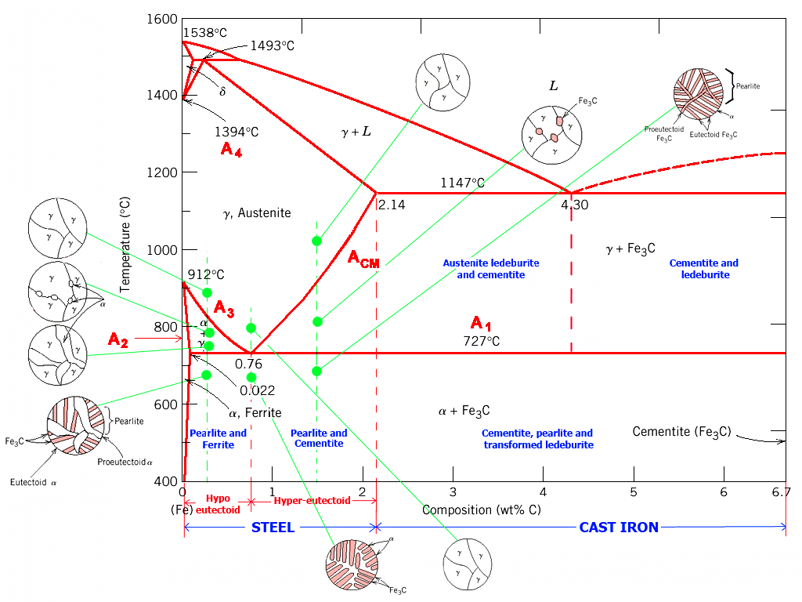
Iron Carbon Phase Diagram
Engineering Chemistry and Materials Science
Phase Diagrams
Steel is one of the most important materials engineers use (1878 million tonnes of steel is produced each year)
Steel is a broad term regarding carbon steel compounds but the actual concentration of carbon as well as the thermal treatment can change the performance of steel significantly
Iron carbon system expands the sample principles that govern binary diagrams
Just more solid-solid phase transformations (solvus lines)
Each phase has its own microstructure, key here is the left side, the austinite ferrite transformations are very important to the steel industry
APS110/164

Slide 6
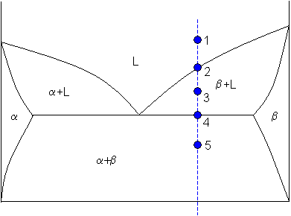
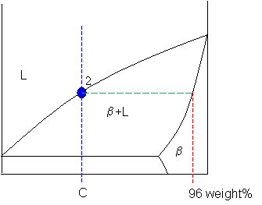





Lever Rule
Engineering Chemistry and Materials Science
Phase Diagrams
The lever rule can help us determine how much of each phase is present in a material when we have more than one phase present
Apply this to many positions on a graph to determine our compositions
Use a liquid mixture cooling to apply the lever rule
Red x’s denote positions of maximum solubility, for example on the left x, we can say that the max solubility of B in A, is ~10% at the eutectic temperature – meaning that you can form a compound of alpha phase without any beta phases present with up to 10 wt% B
1: Pure liquid phase so we have 100% liquid
2: Passed the liquidous line, start forming solid beta phase, draw a line from the point at which the beta phase starts forming at 96 wt% B, beta phase
APS110/164

Slide 7
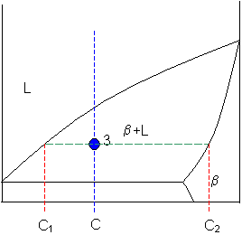
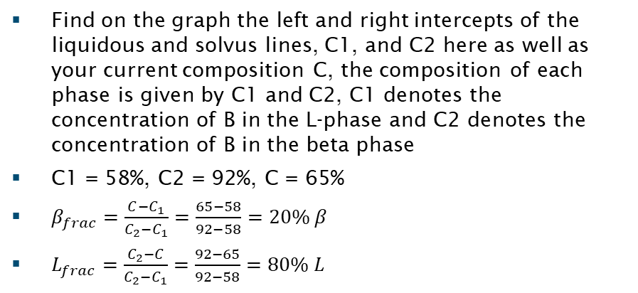
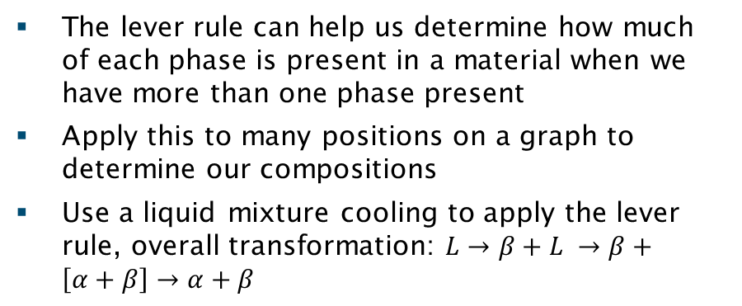
Lever Rule
Engineering Chemistry and Materials Science
Phase Diagrams
The lever rule can help us determine how much of each phase is present in a material when we have more than one phase present
Apply this to many positions on a graph to determine our compositions
Use a liquid mixture cooling to apply the lever rule, overall transformation: $L→β+L →β+\left[α+β\right]→α+β$
3: Now need to use the lever rule to determine the phases present, have L and beta
Find on the graph the left and right intercepts of the liquidous and solvus lines, C1, and C2 here as well as your current composition C, the composition of each phase is given by C1 and C2, C1 denotes the concentration of B in the L-phase and C2 denotes the concentration of B in the beta phase
C1 = 58%, C2 = 92%, C = 65%
$β_{frac}=\frac{C−C_{1}}{C_{2}−C_{1}}=\frac{65−58}{92−58}=20\% β$
$L_{frac}=\frac{C_{2}−C}{C_{2}−C_{1}}=\frac{92−65}{92−58}=80\% L$
APS110/164

Slide 8
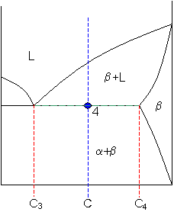
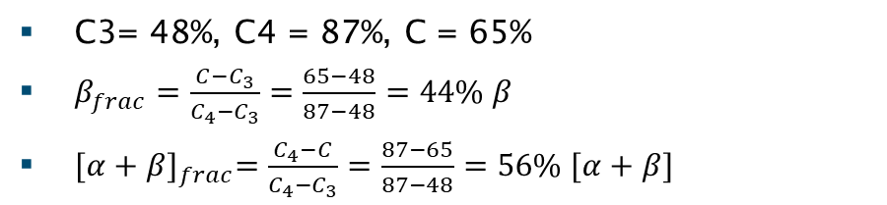
Lever Rule
Engineering Chemistry and Materials Science
Phase Diagrams
The lever rule can help us determine how much of each phase is present in a material when we have more than one phase present
Apply this to many positions on a graph to determine our compositions
Use a liquid mixture cooling to apply the lever rule
4: Now cooled such that no L remains, now balancing between beta and a eutectic (mixed) phase
C3= 48%, C4 = 87%, C = 65%
$β_{frac}=\frac{C−C_{3}}{C_{4}−C_{3}}=\frac{65−48}{87−48}=44\% β$
${[α+β]}_{frac}=\frac{C_{4}−C}{C_{4}−C_{3}}=\frac{87−65}{87−48}=56\% [α+β]$
APS110/164

Slide 9
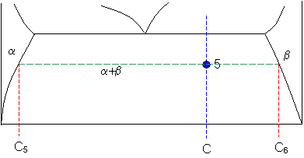
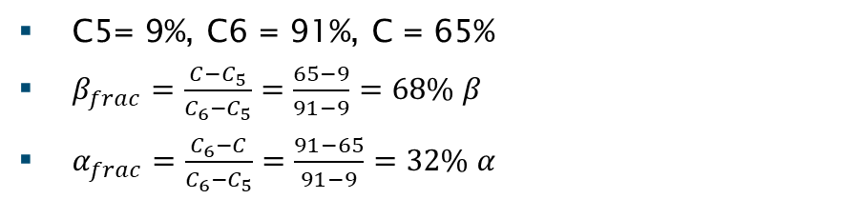
Lever Rule
Engineering Chemistry and Materials Science
Phase Diagrams
The lever rule can help us determine how much of each phase is present in a material when we have more than one phase present
Apply this to many positions on a graph to determine our compositions
Use a liquid mixture cooling to apply the lever rule
Now having passed the eutectic temperature, the pre-eutectic beta is now also transforming into a mixed phase, the relative amounts of each can be solved as follows
C5= 9%, C6 = 91%, C = 65%
$β_{frac}=\frac{C−C_{5}}{C_{6}−C_{5}}=\frac{65−9}{91−9}=68\% β$
$α_{frac}=\frac{C_{6}−C}{C_{6}−C_{5}}=\frac{91−65}{91−9}=32\% α$
APS110/164

Slide 10
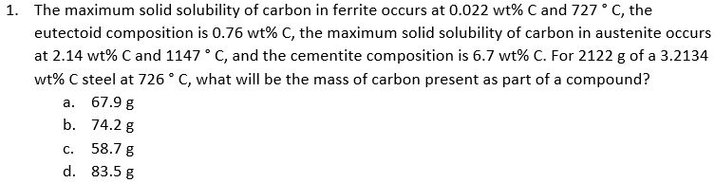
Practice Problem #1
Engineering Chemistry and Materials Science
Practice Problems
APS110/164

Slide 11
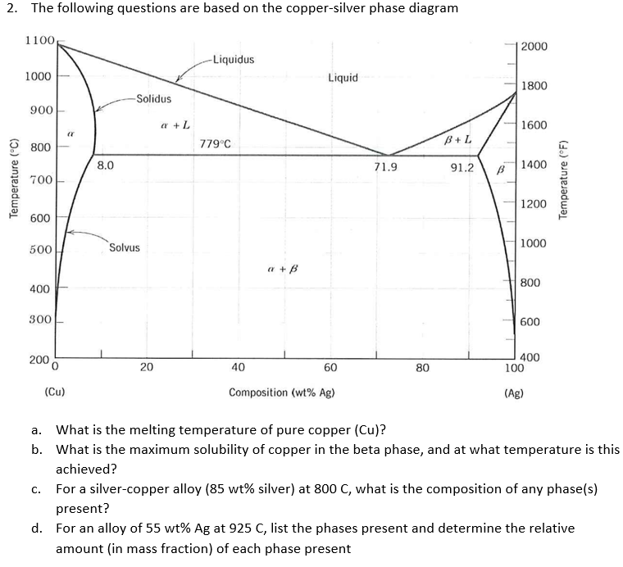
Practice Problem #2
Engineering Chemistry and Materials Science
Practice Problems
APS110/164

Slide 12
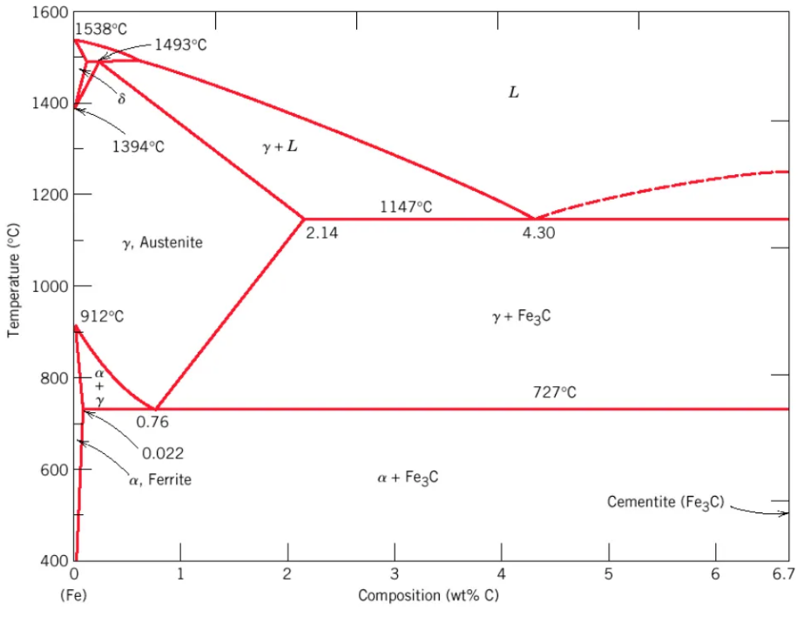
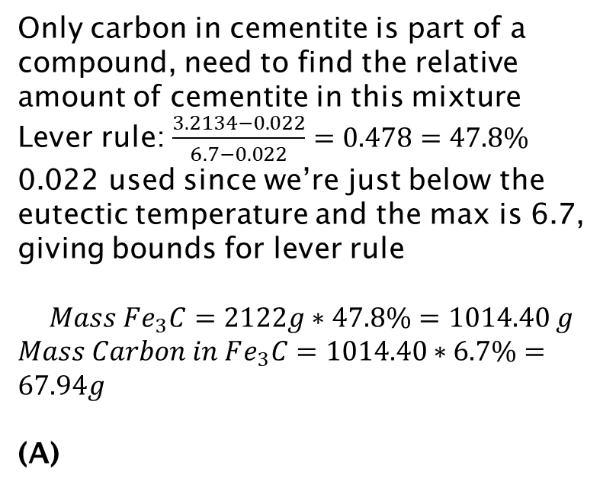
Practice Problem #1
Engineering Chemistry and Materials Science
Practice Problems
Only carbon in cementite is part of a compound, need to find the relative amount of cementite in this mixture Lever rule: $\frac{3.2134−0.022}{6.7−0.022}=0.478=47.8\%$
0.022 used since we’re just below the eutectic temperature and the max is 6.7, giving bounds for lever rule
$$Mass Fe_{3}C=2122g∗47.8\%=1014.40 g$$
$Mass Carbon in Fe_{3}C=1014.40∗6.7\%=67.94g$
(A)
APS110/164

Slide 13
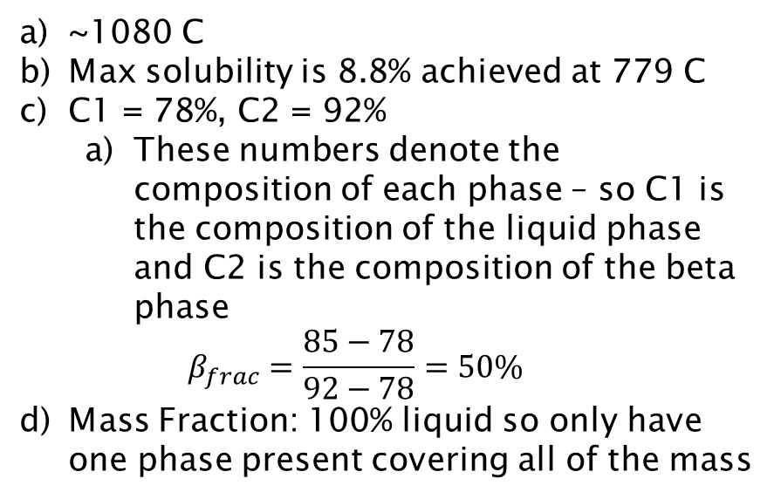
Practice Problem #2
Engineering Chemistry and Materials Science
Practice Problems
~1080 C
Max solubility is 8.8% achieved at 779 C
C1 = 78%, C2 = 92%
These numbers denote the composition of each phase – so C1 is the composition of the liquid phase and C2 is the composition of the beta phase
$$β_{frac}=\frac{85−78}{92−78}=50\%$$
Mass Fraction: 100% liquid so only have one phase present covering all of the mass
APS110/164

